Slide 1
Module 8: Is Your Infrastructure Well-Architected?
Notes:
Welcome to Module 8: Is Your Infrastructure Well-Architected?
The goal of this module is to introduce the Well-Architected Framework, and to provide a quick overview of each of its five pillars. A deeper explanation of each pillar will be included in the upcoming modules.

Slide 2

What’s in This Module
Part 1: Introduction to the Well-Architected Framework
Part 2: Pillars of the Well-Architected Framework
Part 3: Well-Architected Design Principles
Notes:
Part 1 introduces you to the Well-Architected Framework. In part 2, you will learn about the five pillars of the Well-Architected Framework. And in part 3, you will learn about the general design principles for the Well-Architected Framework.
To prepare for this module and the following modules, review the Well-Architected Framework whitepaper by selecting the link. https://d1.awsstatic.com/whitepapers/architecture/AWS_Well-Architected_Framework.pdf

Slide 3
Module Objectives
Upon completion of this module, you will be able to:
Identify the five pillars of the AWS Well-Architected Framework.
Identify how the AWS Well-Architected Framework enables them to review and improve their cloud-based architectures.
Reflect on the business impact of their design decisions.
Notes:
Upon completion of this module, you will be able to:
• Identify the five pillars of the Amazon Web Services—or AWS—Well-Architected Framework.
• Identify how the AWS Well-Architected Framework enables you to review and improve your cloud-based architectures.
• And reflect on the business impact of your design decisions.

Slide 4
Introducing the Well-Architected Framework
Notes:
First, let’s introduce you to the Well-Architected Framework.

Slide 5
The AWS Well-Architected Framework
The goal of this framework is to enable customers to:
Assess and improve architectures.
Better understand the business impact of design decisions.
It provides a set of questions developed by AWS experts to help customers think critically about their architecture.
Does your infrastructure follow best practices?
Notes:
The goal of the AWS Well-Architected Framework is to enable customers to:
• Assess and improve architectures.
• And better understand the business impact of design decisions.
It provides a set of questions that AWS experts developed to help customers think critically about their architecture.
The Well-Architected Framework asks, "Does your infrastructure follow best practices?"

Slide 6
The AWS Well-Architected Framework
Architects should leverage the AWS Well-Architected Framework in order to:
Increase awareness of architectural best practices.
Address foundational areas that are often neglected.
Evaluate architectures using a consistent set of principles.
Notes:
Architects should use the AWS Well-Architected Framework to increase awareness of architectural best practices, such as security, cost optimization, and performance efficiency. These best practices are foundational areas that are often neglected, so be sure to address them. You should also evaluate your architectures by using a consistent set of principles.

Slide 7
The AWS Well-Architected Framework
The AWS Well-Architected Framework does not provide:
Implementation details
Architectural patterns
Relevant case studies
However, it does provide:
Questions centered on critically understanding architectural decisions
Services and solutions relevant to each question
References to relevant resources
Notes:
The AWS Well-Architected Framework does not provide:
• Strict implementation details
• Architectural patterns
• Or relevant case studies
However, it does provide:
• Questions centered on critically understanding architectural decisions.
• Services and solutions that are relevant to each question.
• And references to relevant resources.
It helps you think critically about your infrastructure, and how to run it in the most efficient, cost-optimized way possible.

Slide 8
Pillars of the Well-Architected Framework
Notes:
Now, let’s learn about the pillars of the Well-Architected Framework.

Slide 9


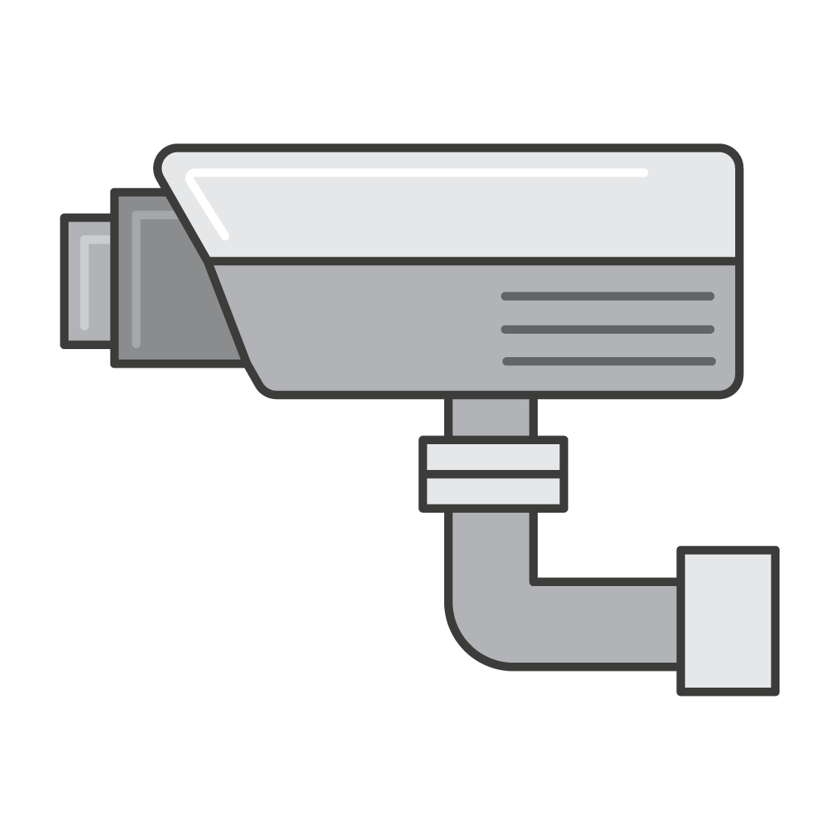

Pillars Of The Well-Architected Framework
Operational Excellence
Security
Reliability
Performance Efficiency
Cost Optimization
Recover from failure and mitigate disruption.
Deliver business value
Protect and monitor systems
Eliminate unneeded expense.
Use resources sparingly.
Notes:
The Well-Architected Framework guides you through looking at the design of your application from five different perspectives, or pillars.
These pillars include:
• Operational excellence to deliver business value
• Security to protect and monitor systems
• Reliability to recover from failure and mitigate disruption
• Performance efficiency to use resources sparingly
• And cost optimization to eliminate unneeded expenses.

Slide 10


Operational Excellence
Operational Excellence
The ability to run and monitor system:
To deliver business value.
To continually improve supporting processes and procedures.
Deliver business value
Notes:
Operational excellence involves the ability to run and monitor the system, which helps to deliver business value and continually improve supporting processes and procedures.

Slide 11
Security
Security
The ability to protect:
Information
Systems
Assets
While delivering business value through:
Risk assessments
Mitigation strategies
Protect and monitor systems
Notes:
Security is the ability to protect information, systems, and assets.
Security also delivers business value through risk assessments and mitigation strategies.

Slide 12
Reliability
Reliability
The ability of a system to:
Recover from infrastructure or service failures.
Dynamically acquire computing resources to meet demand.
Mitigate disruptions such as:
Misconfigurations
Transient network issues
Recover from failure and mitigate disruption.
Notes:
Reliability allows your system to:
• Recover from infrastructure or service failures in the case of a catastrophic event.
• Dynamically acquire computing resources to meet demand.
• And mitigate disruptions, such as misconfigurations and transient network issues.

Slide 13
Performance Efficiency
Performance Efficiency
The ability to:
Use computing resources efficiently to meet system requirements.
Maintain that efficiency as demand changes and technologies evolve.
Use resources sparingly.
Notes:
Performance efficiency is the ability to use computing resources efficiently to meet system requirements, such as rightsizing your instance or using the appropriate instance size for the job. You want to be sure the system maintains that efficiency as demand changes and technologies evolve.

Slide 14
Cost Optimization
Cost Optimization
The ability to avoid or eliminate:
Unneeded cost.
Suboptimal resources.
Eliminate unneeded expense.
Notes:
Cost optimization is the ability to avoid or eliminate unneeded costs and suboptimal resources. You don’t want to pay for something that you don’t need, or that you’re not using.

Slide 15
Well-Architected Design Principles
Notes:
Finally, let’s learn about the design principles for the Well-Architected Framework.

Slide 16

Well-Architected Design Principles
The Well-Architected Framework also identifies a set of general design principles to facilitate good design in the cloud:
Stop guessing your capacity needs.
Test systems at production scale.
Automate to make architectural experimentation easier.
Allow for evolutionary architectures.
Drive architectures using data.
Improve through game days.
Notes:
The Well-Architected Framework identifies a set of general design principles to facilitate good design in the cloud.
Stop guessing your capacity needs.
Test systems at production scale.
Automate to make architectural experimentation easier.
Allow for evolutionary architectures.
Drive architectures using data.
And improve through game days.

Slide 17
Stop Guessing Your Capacity Needs
Traditional Environment
When you make a capacity decision before you deploy a system, you might end up wasting expensive idle resources or dealing with the performance implications of limited capacity.
Cloud Environment
Eliminate guessing your infrastructure capacity needs.
Use as much or as little capacity as you need and scale up and down automatically.
Notes:
In a traditional environment, you might make a capacity decision before you deploy a system, and end up wasting expensive idle resources or dealing with the performance implications of limited capacity.
In a cloud environment, you can eliminate the process of guessing your needs for infrastructure capacity. You can use as much or as little capacity as you need, and scale up or down automatically.

Slide 18
Test Systems at Production Scale
Traditional Environment
It is usually cost-prohibitive to create a duplicate environment solely for testing.
Most test environments are not tested at live levels of production demand.
Cloud Environment
Create a duplicate environment on demand, complete your testing, and then decommission the resources.
Only pay for the test environment when it is running, so you can simulate your live environment for a fraction of the cost of testing on premises.
Notes:
In a traditional, non-cloud environment, it is usually cost-prohibitive to create a duplicate environment solely for testing. Consequently, most test environments are not tested at live levels of production demand.
In the cloud, you can create a duplicate environment on demand, complete your testing, and then decommission the resources. Because you only pay for the test environment when it is running, you can simulate your live environment for a fraction of the cost of testing on premises.

Slide 19
Automate to Make Architectural Experimentation Easier
Traditional Environment
On-premises environments have separate structures and components that require more work to automate (no common API for all parts of your infrastructure).
Cloud Environment
Create and replicate your systems at low cost (no manual effort).
Track changes to your automation, audit the impact, and revert to previous parameters when necessary.
Notes:
On-premises environments have separate structures and components that can require more work to automate because they might not have a common API for all parts of the infrastructure.
In a cloud environment, automation allows you to create and replicate your systems at low cost or with no manual effort. You can track changes to your automation, audit the impact, and revert to previous parameters when necessary.

Slide 20
Allow for Evolutionary Architectures
Traditional Environment
Architectural decisions are often implemented as static, one-time events.
There may be only a few major versions of a system during its lifetime.
As a business changes, initial decisions may hinder the ability to meet changing business requirements.
Cloud Environment
The capability to automate and test on demand lowers the risk of impact from design changes.
Systems can evolve over time so that businesses can take advantage of new innovations as a standard practice.
Notes:
In a traditional environment, architectural decisions are often implemented as static, one-time events, and they often have a few major versions of a system during its lifetime. As a business changes, these initial decisions can hinder the system’s ability to meet changing business requirements.
In the cloud, the ability to automate and test on demand lowers the risk of impact from design changes. This allows systems to evolve over time so that businesses can take advantage of new innovations as a standard practice.

Slide 21
Drive Architectures Using Data
Traditional Environment
Architectural decisions are often an area that is chosen according to organizational defaults.
Data sets generally can not be generated.
Models and assumptions to size your architecture are probably used.
Cloud Environment
Collect data on how your architectural choices affect the behavior of your workload.
Make fact-based decisions on how to improve your workload.
Use that data to inform your architecture choices and improvements over time.
Notes:
In a traditional, non-cloud environment, architectural decisions are often made according to organizational defaults, instead of through a data-driven approach. You generally cannot generate data sets that would allow you to make informed decisions, so you probably use models and assumptions to size your architecture.
In the cloud, you can collect data on how your architectural choices affect the behavior of your workload, which you can use to make fact-based decisions on how to improve your workload. Your cloud infrastructure is code, so you can use that data to inform your architectural choices and improvements over time.

Slide 22
Improve Through Game Days
Traditional Environment
You would only exercise your runbook when something bad happens in production.
Cloud Environment
Test how your architecture and processes perform by scheduling game days to simulate events in production.
Understand where improvements can be made and develop organizational experience in dealing with events.
Notes:
In a traditional environment, you would only exercise your runbook when something bad happens in production.
In the cloud, you can test how well your architecture and processes perform by regularly scheduling game days to simulate events in production. This process will help you understand where you can make improvements, and it can help your organization develop experience in dealing with events.

Slide 23

In Review
Learned how to assess and improve your architectures.
Identified key features and benefits of the Well-Architected Framework.
Discovered design principles to facilitate good architectural design in the cloud. To finish this module:
Complete:
Knowledge Assessment
Notes:
In review, you:
• Learned how to assess and improve your architectures.
• Identified key features and benefits of the Well-Architected Framework .
• And discovered design principles to facilitate good architectural design in the cloud.
To finish this module, please complete the corresponding knowledge assessment.
23

Slide 24
Up Next: Well-Architected Pillar 1: Operational Excellence
Notes:
Next, you’ll be introduced to Well-Architected Pillar 1: Operational Excellence.

Slide 25
Thanks for participating!
© 2018 Amazon Web Services, Inc. or its affiliates. All rights reserved. This work may not be reproduced or redistributed, in whole or in part, without prior written permission from Amazon Web Services, Inc. Commercial copying, lending, or selling is prohibited. Corrections or feedback on the course, please email us at: aws-course-feedback@amazon.com. For all other questions, contact us at: https://aws.amazon.com/contact-us/aws-training/. All trademarks are the property of their owners.
Notes:
Thank you for participating!

